Slide 1
FEE Final Evaluation
NAME: Abhay Gupta
ROLL: 2110991952
GROUP: G5
Year: 3rd
INSTRUCTOR: Lavish Arora

Slide 2
PROJECT TITLE: NIKON
NIKON,as the name suggests is a website for selling Nikon DRLRs
The webpage also has an option to buy accessories for the DSLRs

Slide 3
WHY NIKON?
Nikon has a rich history of producing high-quality cameras, and I wanted to showcase their offerings in a way that highlights their strengths and features. This website is a tribute to their craftsmanship.
The decision to build this website was also stemmed from my passion for photography and a desire to create a platform that caters to the needs of fellow photography enthusiasts.

Slide 4
OVERVIEW
NIKON is a full-fledged website which has 20 webpages
Various technologies used: HTML5,CSS3,JavaScript,BootStrap5,Font Awesome
Github: https://github.com/AbhayG21/NIKON

Slide 5
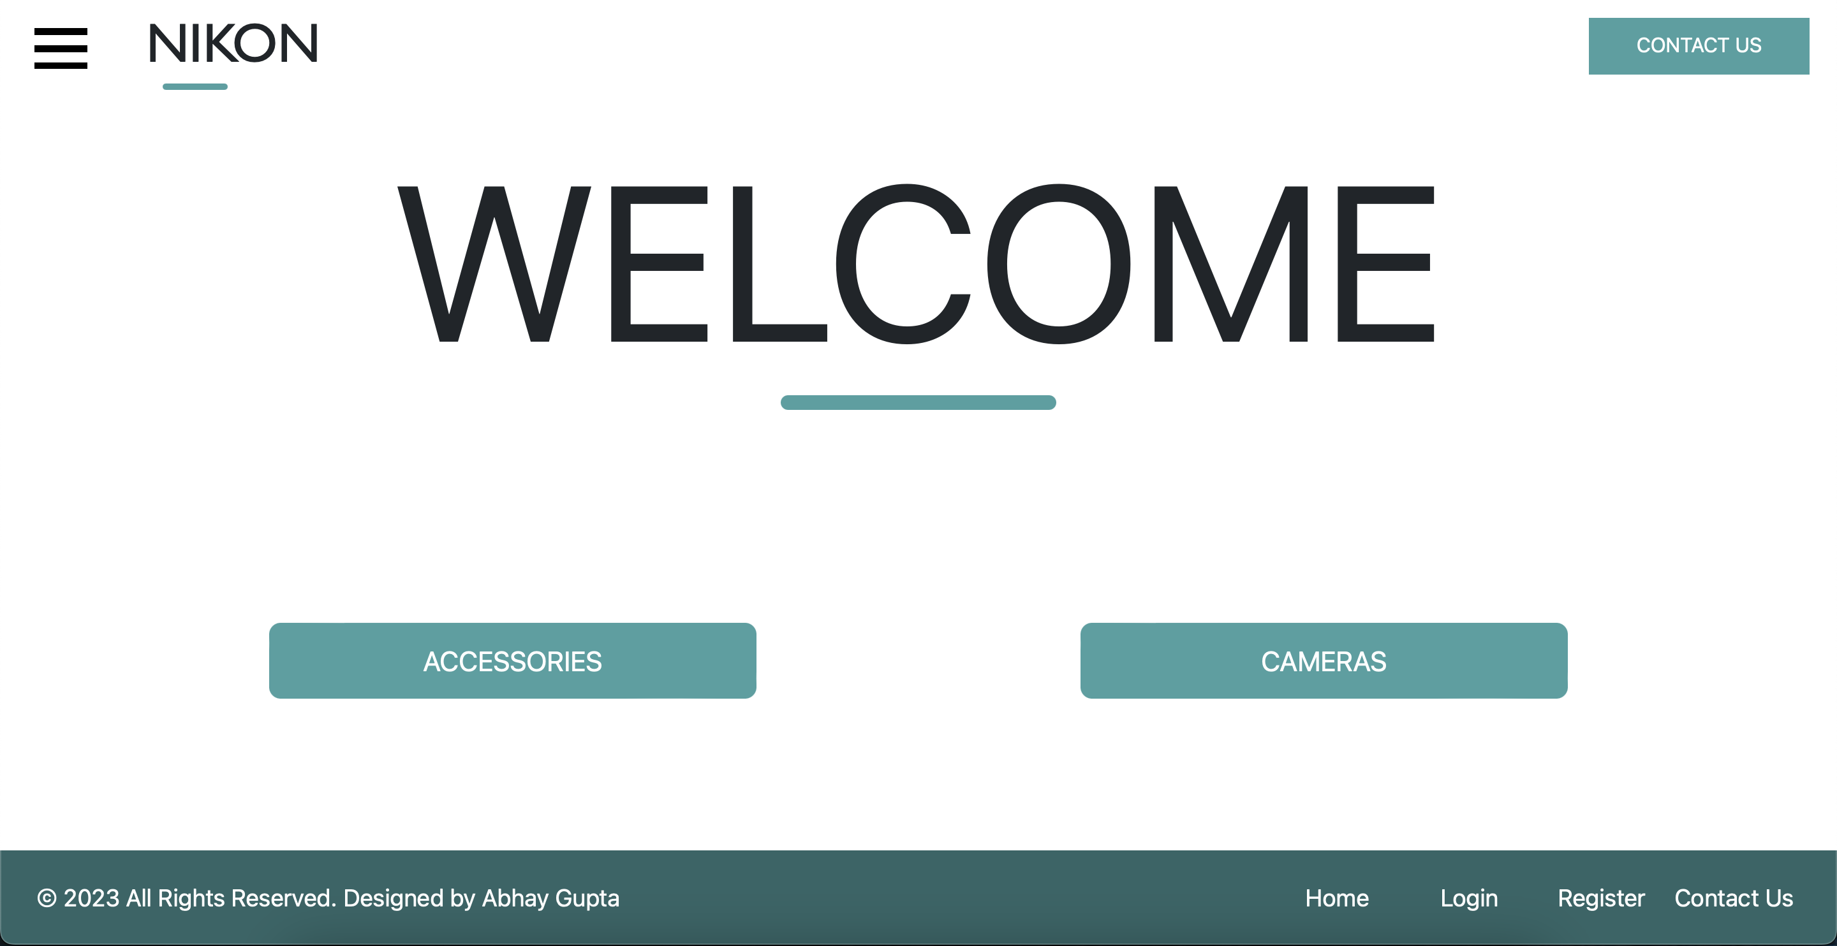
LANDING PAGE

Slide 6
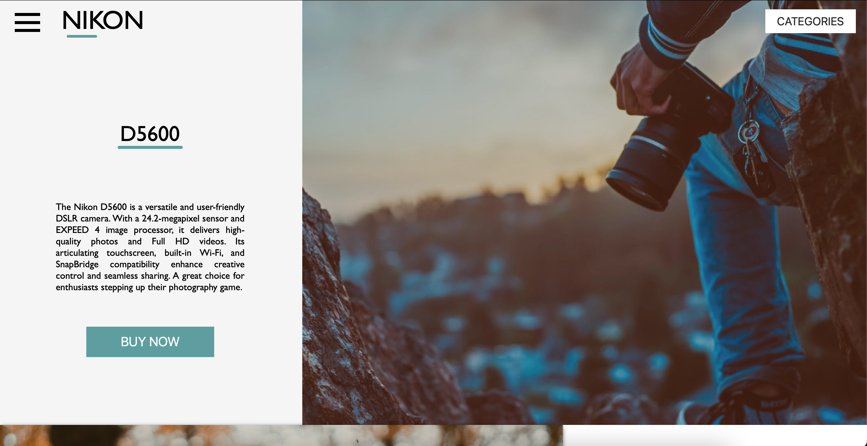
DSLR LANDING PAGE

Slide 7
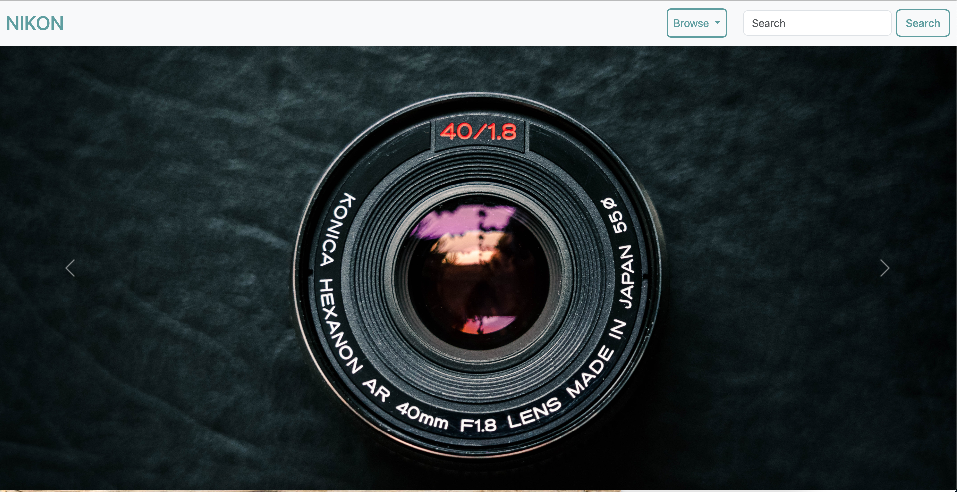
ACCESSORIS LANDING PAGE

Slide 8

Problems Faced:
Responsiveness: Making the webpage responsive was a challenge as some of the elements changed their positions when screen size was changed.
UI and UX: Making the UI more user friendly and optimizing the User Experience.
Redesigning certain webpages using Bootstrap.

Slide 9
LEARNINGS
Creating cart system on webpage
Changing images on click
Changing whole set of data on comparison page
Deeper understanding of various concepts of HTML, CSS, JavaScript

Slide 10

THANK YOU

